Slide 1

Puberty and how a pregnancy happens
5th Grade SHARE

Slide 2

Menstruation: What To Expect

Slide 3
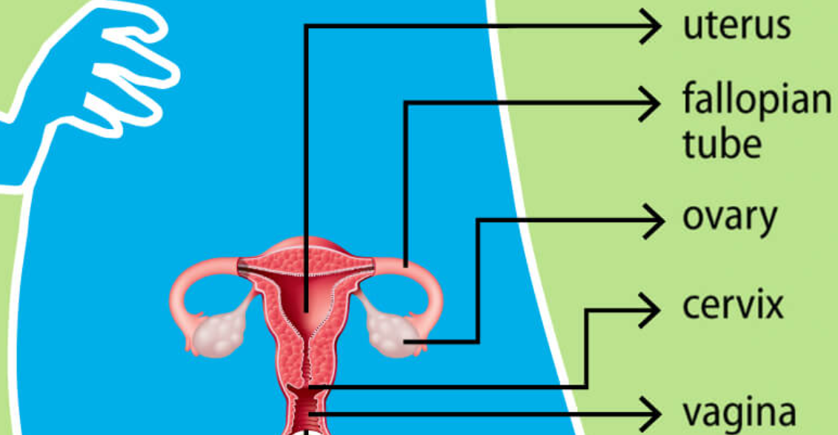

Slide 4

Pregnancy and Reproduction Explained

Slide 5
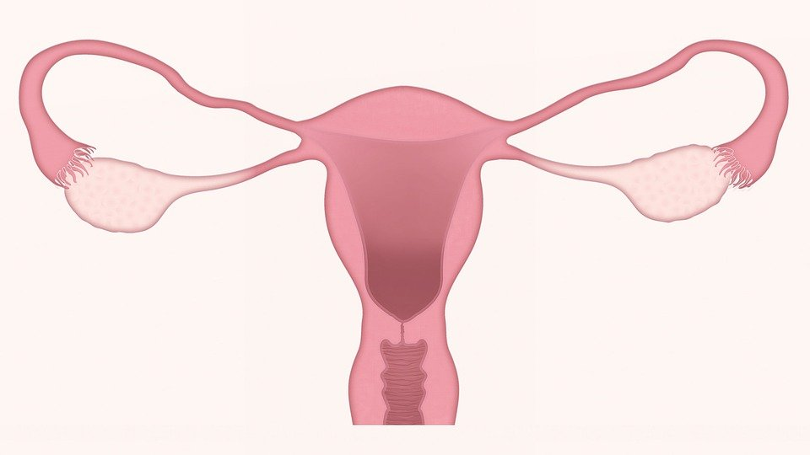

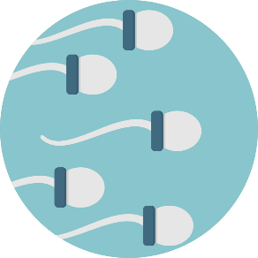
fallopian tube
fallopian tube
uterus
ovary
ovary
sperm

Slide 6
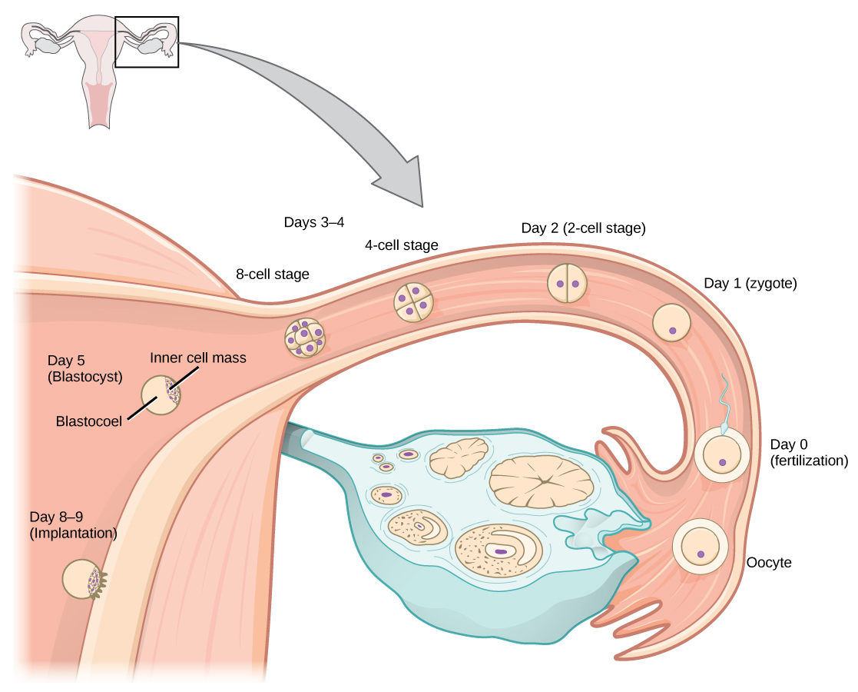
Fertilization of an egg
Fallopian Tube
Uterus
Sperm-fertilizes egg
Egg –ovulation (ovary releases mature egg)
Ovary- filled with immature eggs

Slide 7
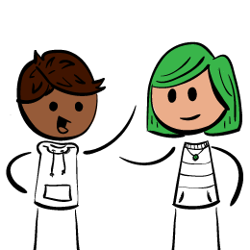
Activity
With a partner
Complete “How Pregnancy Happens”

Slide 8
3 Ways to create a pregnancy
penis-vagina sexual intercourse
artificial insemination
in-vitro fertilization

Slide 9
WCSD Definition of abstinence
    Sexual abstinence is defined as refraining from all forms of sexual activity and genital contact such as vaginal, oral and anal sex.
    An abstinent person is someone who has either never had sex or someone who has had sex but who has decided not to continue having sex for a period of time.
    Abstinence is the only 100% effective way to prevent sexually transmitted HIV, other sexually transmitted diseases or infections and pregnancy.
      Sex-when a person’s genitals touch another person’s genitals, mouth or anus.
      Pregnancy most commonly results from vaginal sex.

Slide 10
Who can you talk to?
Parent or Guardian
Trusted adult
School Counselor
School Nurse
Teacher
Faith based leader
Health Clinic
Health care provider

Slide 11
Exit Slip
When a sperm gets inside an egg, it’s called?
What does an egg with a sperm inside it have to do before a pregnancy can start?

